Slide 1
4 DevOps principles for your cross-platform database team
Chris Unwin, Data Privacy and Protection Specialist, Redgate
Notes:
Hello everybody and welcome to today’s webinar on 4 key DevOps principles for cross-platform database teams. The DevOps principles that we’re going to talk about today are applicable to all database platforms but our primary focus is going to be on SQL Server and Oracle.
We’ll start off by a couple of slides talking about DevOps followed by product demos of how Redgate can help you implement the DevOps principles that we’re going to talk about today across your SQL Server and Oracle database projects.

Slide 2


Your Presenter
Chris Unwin
Data Privacy and Protection Specialist
Chris.Unwin@red-gate.com
/in/christopherunwincambridge/
DBAle on Spotify and iTunes
Notes:
[Introduce yourself]
Articles
DBAle
3 years at Redgate

Slide 3
About Redgate
300
2m
19
202,000
Redgaters and counting
years old
customers
SQL Server Central and Simple Talk users
91%
4m
1147
68
of the Fortune 100 use our tools
website visits each year
product releases last year
User Groups sponsored last year
Notes:
Now for those of you who are new to Redgate. We’ve been in the business for just over 18 years specializing in solutions for SQL Server and Oracle platforms helping developers and DBAs improve their practices around database change management, delivery, data compliance and monitoring.
We’re also pretty big on supporting the community. We have over 2 million active users on our sql server central and simple talk websites which has now become the Redgate Hub and we also sponsor a lot of free events such as SQL Saturdays and different user and DevOps groups.
Another thing that I’d like to draw your attention to here is the number of product releases for past year. As a software company we really do practice what we preach. We had total of 1147 minor and major releases and we’ve actually seen a significant uptake in this number over the past couple of years as a result of continuously improving our DevOps practices internally and being able to delivery value to our customers faster and more frequently.

Slide 4
Agenda
What is DevOps?
Extending DevOps practices to the database
4 DevOps principles for your database team
Data Masking
Source control
Continuous Integration
Release management
Notes:
So what are we focusing on today. We’ll quickly remind ourselves of what devops is and what it means in the context of databases. then we’ll move on to talking about the 4 principles that any database shops should follow in order to implement a successful DevOps pipeline. Staring with Data masking which is the key to having a compliant devops process followed by the other 3 principles which are …. that aren’t really specific to just databases. They apply to both application code and databases. And we’ll wrap up our session with Q&A and next steps.

Slide 5
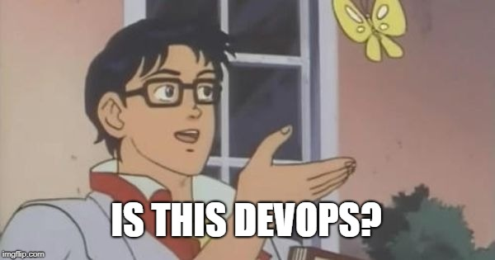
A DevOps fallacy
MANAGERS
DEVELOPERS
VENDORS
MORE FEATURES
AUTOMATION
TOOLS

Slide 6
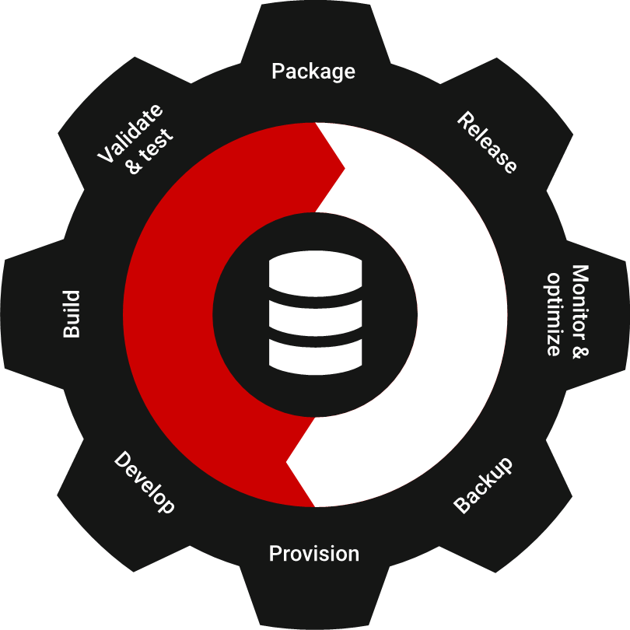
“DevOps is the union of people, process, and products to enable continuous delivery of value to our end users.”
Donovan Brown,
Principal DevOps Program Manager, Microsoft
Notes:
Before we look at the 4 principles, let’s make sure everyone’s on the same page as to what DevOps is because if you ask 10 different people what DevOps is you’re gonna get 10 different answers. Some might say DevOps is all about automation, devOps is about delivering more features, or some bad ones such as devOps is a team of engineers who know Powershell.
But here’s the definition of DevOps from Microsoft’s point of view that hopefully resonates with you all. So ….
The key things to take a note of here is the words People, process and products. What this means is that you can’t just go and buy some DevOps tools and say we’re a DevOps shop now or you can’t sit your devs and DBAs next to each other and say we removed the walls between devs and Ops so we’re doing DevOps. DevOps is not something that you implement once and you’re done. It’s a journey that requires continuous improvement in these 3 areas. Having the right people and processes is key to the success of any DevOps initiative. And then tooling comes next.
The other important thing to note here is we’re talking about delivery of value not features or more code. Because The ultimate goal of any DevOps initiative should be to deliver more value to your customers quicker in order to stay ahead of competition and be able to easily accommodate new market changes.

Slide 7
Extending DevOps to your database provides:
Repeatability of processes
Greater predictability over releases
Faster speed of response to change
Greater reliability of the release process
Overall faster delivery of business value
Notes:
Now, let’s talk about DevOps for databases.
So, hopefully by now we all understand the benefits of DevOps and here we’ve highlighted some of them.
One common trend that I see from working with different organizations is that most application teams have modernized their development and delivery process and have introduced automated testing and releases whereas development and release processes around databases are still neglected and most organizations still see the databases as a bottleneck to faster and more frequent delivery of software.
In many organizations, DBAs spend majority of their time reviewing database change scripts that can take anywhere from hours to even days depending on their release frequency and in a lot of cases they have to rework the database scripts multiple times until they’re considered as production ready. Part of this is because it’s difficult to treat database like code. There’s a lot of pressure on DBAs to maintain the integrity and safety of their data in their databases so they can’t just do a simple replace like we do on the code side. another issue is that databases are not stored as text that you can easily source control and put through an automated build and release process.
Bottom line is that we understand the challenges associated with modernizing development and delivery processes for databases and we believe that with the right processes and tooling you can definitely do achieve a true DevOps process for databases and that’s what we’re going to show you next.

Slide 8
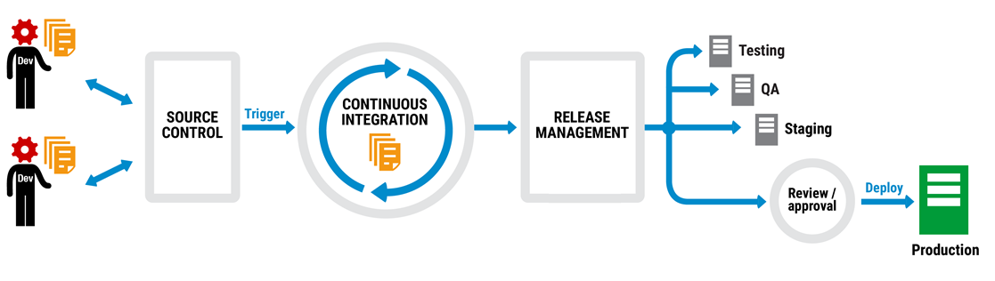
Application automated deployment pipeline
Notes:
So We already said that DevOps is a broad concept and requires the right culture and right people but it’s also about having the right processes and a lot of automation to replace a lot of the manual repetitive tasks that are time consuming and error prone. So, here on the screen we have a typical change management pipeline for code that starts from the left where we have developers making changes and committing them into source control which is one of the fundamental principles to a successful devops pipeline and we’re going to talk about that in greater details.
So, again most of your are probably already doing this for your app code but databases are left behind.

Slide 9
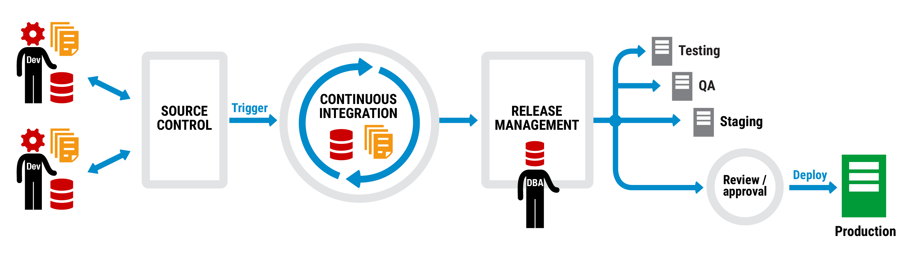
Application and database deployment pipeline
Notes:
At Redgate, we believe that the same principles should be applied to databases without having to change much on what we’re already doing with the app code – so we believe that the same techniques and steps should be taken but of course with the addition of data and the DBAs to oversee the release management process.

Slide 10
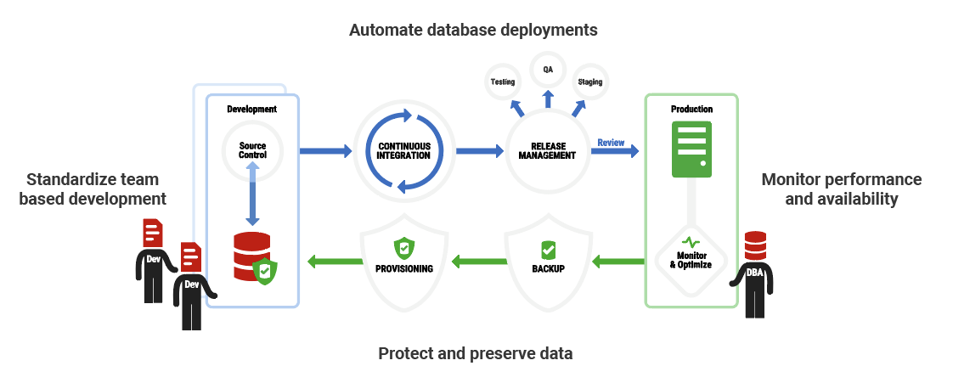
A complete process – Compliant Database DevOps
Notes:
By extending traditional DevOps practices to the database…..
This is Redgate’s preferred Database DevOps process – which encompasses both of the priorities we discussed earlier – the need for increased innovation and regular releases and updates, while also enforcing data privacy and protection.
There are 4 key areas you need to considered if you’re going to achieve Compliant Database DevOps – go through them at a very high level

Slide 11
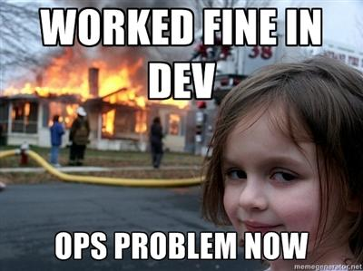
A complete process means less of this…

Slide 12
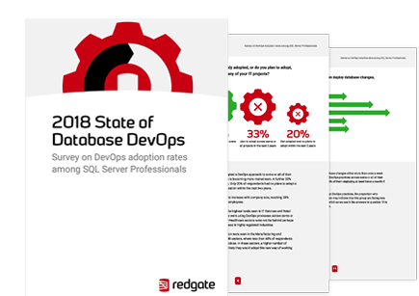
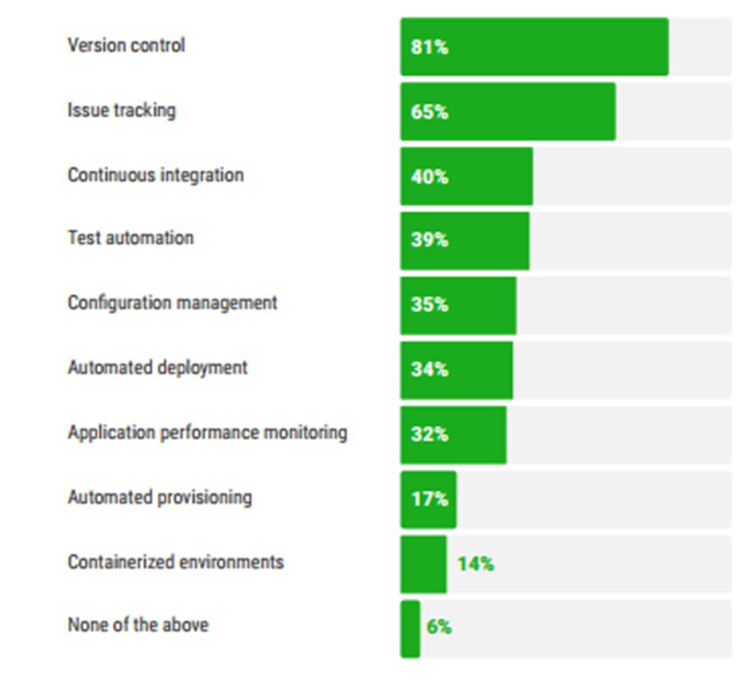

Where are we now?
Which, if any, of these practices are already in place for your Application development?
Which, if any, of these practices are already in place for your Database development?
Notes:
You may be familiar with Puppet’s State of DevOps report. Given the importance of the database within these DevOps practices, Redgate has, for the past few years, done a State of Database DevOps report.
Unsurprisingly, as you can see from this graph, the development practices you associate with DevOps; version control, CI, automated deployments etc, are more common place in the application

Slide 13
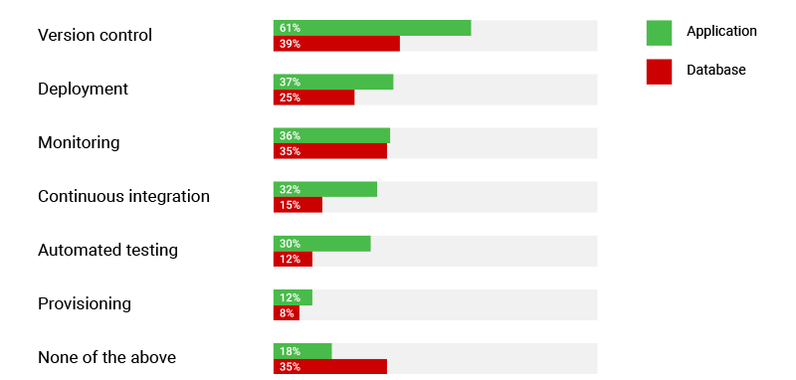
Where are we now?
Has your organization brought in third party tooling to aid your application development in any of these areas?
Notes:
Unsurprisingly, given the previous slide, there is significantly more third-party tooling in place for the application and significantly less resource/tooling for those working on the db. This is particularly prevalent when you look at practices such as version control, deployments and automated testing.

Slide 14
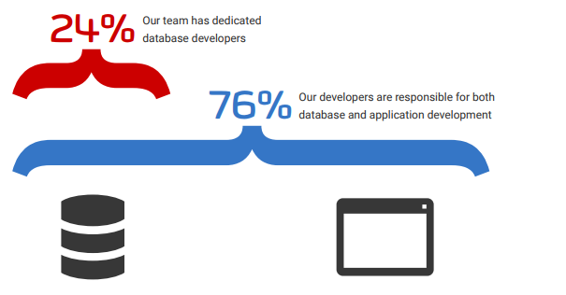
Where are we now?
Does your team include any developers that work across both the Database(s) and the Application(s)
Notes:
But given that more and more people are working across both the application and the database, we need to reduce this gap.
76% of respondents have developers in their team who work across both applications and databases. But the greatest challenge with integrating database changes into a DevOps process would still be synchronizing application and database changes, and overcoming different approaches to development within these multi-functional teams.

Slide 15
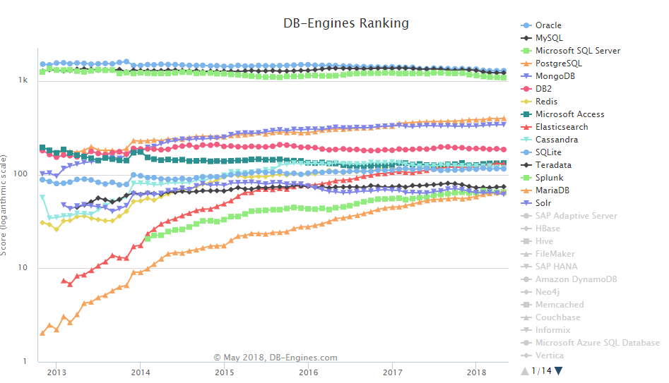
Database Management Systems - Popularity
Notes:
In addition to more people working across both the application and the database, thanks to new development projects, mergers and acquisitions, and a range of other business scenarios, organizations are adopting more and more databases of various types.
DB-Engines Ranking ranks database management systems according to their popularity. In today’s webinar we’ll be discussing two of the most popular platforms in detail, and what DevOps techniques you can adopt when you’re working across SQL Server, Oracle, or a combination of the two.

Slide 16
4 DevOps principles for your cross-platform database team
Notes:
In the State of DevOps report, Puppet identified that comprehensive use of version control; continuous integration; integrating security into software delivery work; and the use of test and deployment automation were fundamental to DevOps success.
We’re going to dive into these in a bit more detail now and demonstrate how you can extend these practices to your SQL Server or Oracle database development

Slide 17

Step 1: Data masking for compliance
Notes:
Development environment- realistic data

Slide 18

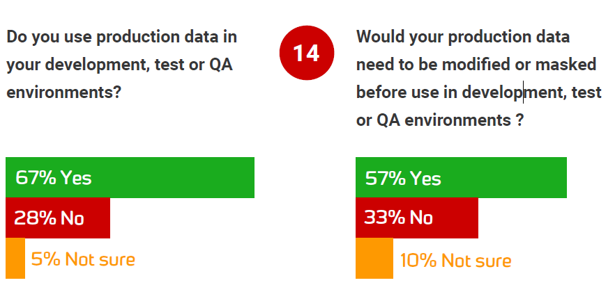
Notes:
**LOUISE TO RUN POLL**
DO YOU MASK THE PRODUCTION YOU USE IN YOUR DEVELOPMENT, TEST, OR QA ENVIRONMENT?
This clearly highlights concerns around data protection and compliance, and with 63% of respondents thinking that a DevOps approach to the database would have a positive impact on regulatory and compliance requirements, it’s no surprise that DevOps adoption is gathering momentum.

Slide 19

Step 2: Robust version control
Notes:
Version controlling or source controlling database changes is the first step to better database development practices. Ensures database development teams communicate their changes with others in the team, always have a version to roll back to if required, and maintain a solid audit trail.
This can become problematic if new tools enforce strict, unfamiliar procedures and ask database developers to work in a different way from application developers – especially as we saw earlier, that more and more people are working across both.
The key is to integrate with existing version control systems like Git, TFS etc and allow developers to check in changes made directly in their development environments using their preferred IDE.

Slide 20
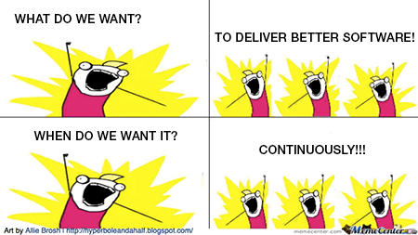
Step 3: Automated builds
Notes:
**LOUISE RUN POLL**
HOW FREQUENTLY DOES YOUR TEAM DEPLOY DATABASE CHANGES, ON AVERAGE?
The best IT performers are reducing the amount of manual work. High performers automate significantly more of their configuration management, testing, deployments and change approval processes than other teams. 33% more configuration mgmt., 27% more testing, 30% more deployments, 27% more change approval processes

Slide 21
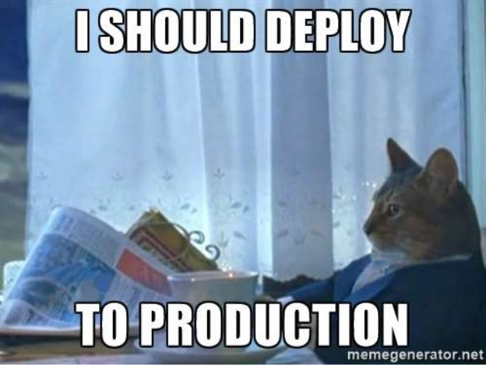
Step 4: Secure release management

Slide 22
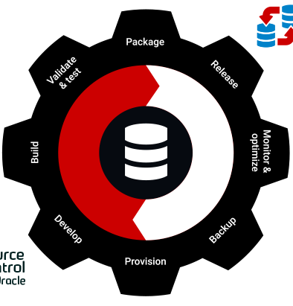




DevOps principles for your cross-platform database team
Notes:
Summary of the tools we’ve demonstrated and the 4 areas we’ve covered – provisioning/data masking, version control, automated deployments, release management. Other areas important to DevOps success not mentioned in today’s webinar and RG has a variety of tools, primarily SQL Server focused to help you throughout the entire DevOps process. More information can be found on our website.

Slide 23
Question and Answer Session

